Slide 1


BGC TRUST UNIVERSITY BANGLADESH
DEPARTMENT OF COMPUTER SCIENCE & ENGINEERING
Machine Learning-Based Analysis of Gene Expression Profiles for Cancer and Liver Disease Classification
PROPOSED BY
SUPERVISED BY
MdTahsin Islam Chowdhury
Md. Asaduzzaman
230240012
Lecturer
Notes:
1

Slide 2
CONTENTS
02 / 14
Outlines
01
Introduction
06
Tools and Technologies
02
Problem Statements
07
Outcomes
03
Research Objectives
08
Conclusion
04
Literature Review
09
References
05
Methodology
BGC Trust University Bangladesh · Department of Computer Science & Engineering
02 / 14
Notes:
2

Slide 3
INTRODUCTION
03 / 14
Introduction
Genomic data science analyzes biological information using computational methods and advanced machine learning techniques.
Cancer and liver disease cause significant global mortality, requiring accurate early diagnostic approaches urgently.
Gene expression analysis identifies molecular patterns associated with disease development, progression, and treatment responses.
Public genomic datasets provide reliable biological information for comparative disease classification research studies.
Machine learning algorithms improve classification accuracy using informative genomic features from gene expression.
Comparative genomic analysis supports biomarker discovery, precision medicine, and effective disease diagnosis advancements.
BGC Trust University Bangladesh · Department of Computer Science & Engineering
03 / 14
Notes:
3

Slide 4
PROBLEM STATEMENTS
04 / 14
Problem Statements
01
02
Comparative genomic analyses between cancer and liver disease remain limited using public genomic datasets.
Existing studies primarily investigate individual diseases instead of comprehensive cross-disease genomic comparisons effectively.
03
04
Shared biomarkers and disease-specific genetic patterns remain insufficiently explored across multiple genomic datasets.
High-dimensional genomic data creates challenges for accurate disease classification using conventional analytical methods.
05
06
Lack of standardized comparative frameworks reduces reliability, reproducibility, and clinical applicability of genomic studies.
Effective machine learning approaches are needed for improved genomic disease classification and biomarker discovery.
BGC Trust University Bangladesh · Department of Computer Science & Engineering
04 / 14
Notes:
4

Slide 5
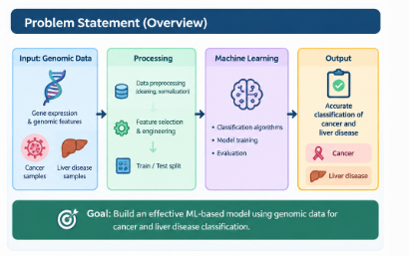
PROBLEM STATEMENT OVERVIEW
05 / 14
Problem Statement (Overview)
BGC Trust University Bangladesh · Department of Computer Science & Engineering
05 / 14
Notes:
5

Slide 6
RESEARCH OBJECTIVES
06 / 14
Research Objectives
Collect and preprocess publicly available genomic datasets from reliable NCBI GEO repositories efficiently.
1
Identify differentially expressed genes associated with cancer and liver disease through comparative genomic analysis.
2
Compare shared and disease-specific gene expression patterns across both selected genomic datasets accurately.
3
Investigate disease-associated genetic variations using standardized bioinformatics techniques and computational analysis methods effectively.
4
Perform Gene Ontology and pathway enrichment analyses identifying significant biological processes and pathways.
5
Discover potential biomarkers improving disease diagnosis, classification, precision medicine, and targeted therapeutic development.
6
BGC Trust University Bangladesh · Department of Computer Science & Engineering
06 / 14
Notes:
6

Slide 7
LITERATURE REVIEW
07 / 14
Literature Review
Author & Year
Research Focus
Key Findings
Research Gap
Oh et al. (2020)
Liver Biomarkers
Identified genomic liver biomarkers
Cancer comparison missing
Ramachandran et al. (2020)
Liver Genomics
Explained liver cellular diversity
Comparative classification absent
Rosati et al. (2024)
DEG Pipelines
Reviewed biomarker identification tools
Cross-disease analysis limited
Shibata & Aburatani (2014)
Liver Cancer Genomics
Improved understanding of mutations
Single disease focus
Yu et al. (2024)
Batch Effect Correction
Increased omics data reliability
Comparative genomic classification absent
BGC Trust University Bangladesh · Department of Computer Science & Engineering
07 / 14
Notes:
7

Slide 8
METHODOLOGY
08 / 14
Methodology
1
Data Collection
Collect cancer and liver disease gene expression datasets from NCBI GEO database repositories.
2
Quality Control
Remove duplicate samples and handle missing values ensuring reliable genomic dataset quality consistently.
3
Preprocessing
Normalize gene expression data and select informative features improving classification performance significantly overall.
4
Data Split
Split processed datasets into seventy percent training and thirty percent testing subsets systematically.
5
Model Training
Train Decision Tree, Random Forest, Support Vector Machine, and KNN classification models effectively.
6
Evaluation
Evaluate model performance using accuracy, precision, recall, F1-score, and confusion matrix metrics.
7
Comparison
Compare classification results identifying optimal machine learning model for genomic disease prediction accuracy.
BGC Trust University Bangladesh · Department of Computer Science & Engineering
08 / 14
Notes:
8

Slide 9
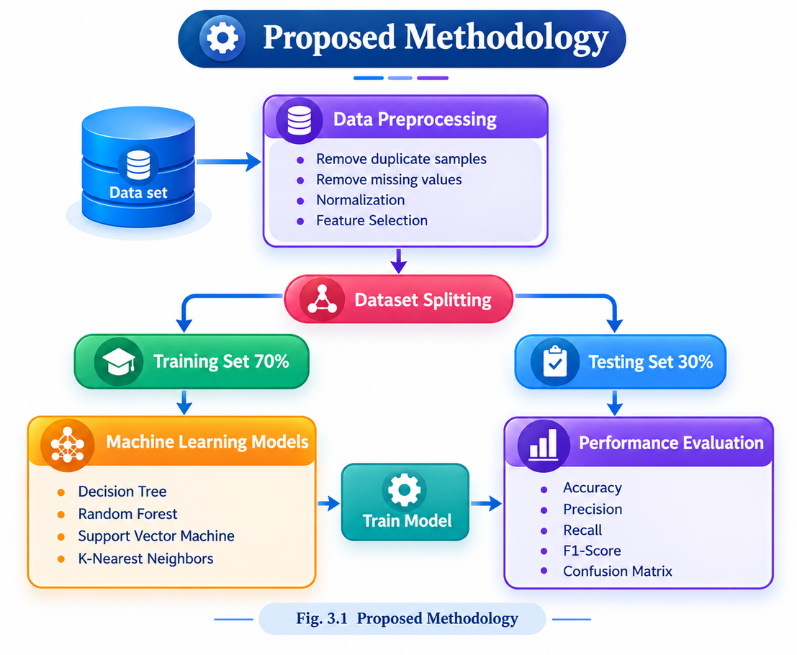
METHODOLOGY
09 / 14
Proposed Methodology
BGC Trust University Bangladesh · Department of Computer Science & Engineering
09 / 14
Notes:
9

Slide 10
TOOLS & TECHNOLOGIES
10 / 14
Tools and Technologies
Python
Jupyter Notebook
NCBI GEO
NumPy
Data preprocessing and machine learning implementation.
Coding, testing, and experiment execution.
Public genomic gene expression datasets.
Numerical computation and array processing.
Pandas
Scikit-learn
Matplotlib & Seaborn
Data cleaning and preprocessing.
Machine learning model development.
Data visualization and performance analysis.
Dataset Info · NCBI Gene Expression Omnibus (GEO)
1. Cancer Dataset: GSE329336 2. Liver Disease Dataset: GSE280687
BGC Trust University Bangladesh · Department of Computer Science & Engineering
10 / 14
Notes:
10

Slide 11
OUTCOMES
11 / 14
Outcomes
Develop an accurate machine learning framework for cancer and liver disease classification successfully.
Identify significant gene expression patterns associated with cancer and liver disease progression accurately.
Discover potential biomarkers supporting early diagnosis and personalized treatment strategies for patients effectively.
Compare machine learning algorithms identifying highest performing model for genomic disease classification accuracy.
Improve understanding of shared and disease-specific molecular mechanisms through comparative genomic analysis studies.
Support future precision medicine research using reliable genomic datasets and computational analytical approaches.
Provide reproducible comparative genomic analysis framework benefiting biomedical researchers and healthcare professionals globally.
BGC Trust University Bangladesh · Department of Computer Science & Engineering
11 / 14
Notes:
11

Slide 12
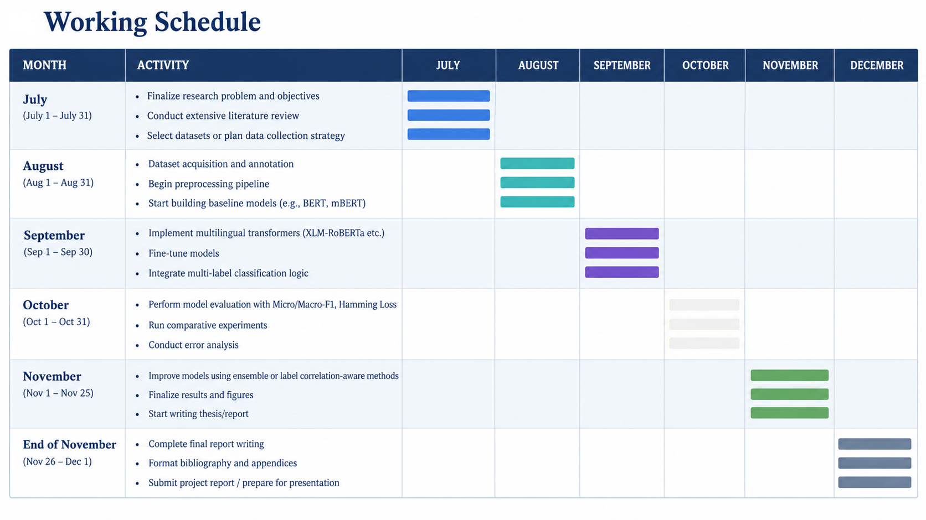
WORKING SCHEDULE
12 / 14
Working Schedule
BGC Trust University Bangladesh · Department of Computer Science & Engineering
12 / 14
Notes:
12

Slide 13
CONCLUSION
13 / 14
Conclusion
Comparative genomic analysis enhances understanding of cancer and liver disease molecular mechanisms effectively.
Machine learning models improve accurate classification using publicly available genomic gene expression datasets.
Data preprocessing ensures reliable genomic information for effective disease prediction and comparative analysis.
Comparative evaluation identifies optimal machine learning algorithms for accurate genomic disease classification performance.
Identified genomic patterns support biomarker discovery and future personalized precision medicine research initiatives.
Proposed framework provides reliable, scalable approach for comparative genomic disease classification and analysis.
Research contributes valuable computational insights supporting future biomedical research and clinical decision making.
BGC Trust University Bangladesh · Department of Computer Science & Engineering
13 / 14
Notes:
13

Slide 14
REFERENCES
14 / 14
References
1.
Oh, S., Jo, Y., Jung, S., Yoon, S., and Yoo, K. H. (2020). From genome sequencing to the discovery of potential biomarkers in liver disease. BMB Reports, 53(6), 299–310.
2.
Ramachandran, P. et al. (2020). Single-cell genomics and spatial transcriptomics in liver physiology and disease biology. Journal of Hepatology, 73(5), 1219–1230.
3.
Rosati, D., Palmieri, M., Brunelli, G., Morrione, A., Iannelli, F., Frullanti, E., and Giordano, A. (2024). Differential gene expression analysis pipelines and bioinformatic tools for the identification of specific biomarkers: A review. Computational and Structural Biotechnology Journal, 23, 1154–1168.
4.
Shibata, T., and Aburatani, H. (2014). Exploration of liver cancer genomes. Nature Reviews Gastroenterology & Hepatology, 11(6), 340–349.
5.
Yu, Y. et al. (2024). Assessing and mitigating batch effects in large-scale omics studies. Genome Biology, 25.
BGC Trust University Bangladesh · Department of Computer Science & Engineering
14 / 14
Notes:
14

Slide 15
6.
Li, L. et al. (2021). Applications of single-cell rna sequencing in cancer research: A systematic review. Journal of Experimental and Clinical Cancer Research, 40
7.
Ma, W. et al. (2024). A review on trends in development and translation of omics signatures in cancer. Computational and Structural Biotechnology Journal..
8.
Ramachandran, P. et al. (2020). Single-cell genomics and spatial transcriptomics in liver physiology and disease biology. Journal of Hepatology, 73(5):1219–1230. .
BGC Trust University Bangladesh · Department of Computer Science & Engineering

